Slide 1


Software Engineering
definition, Software
engineering challenges
Presented By:
B.VAMSI
22551A4408
DATA SCIENCE
GIET
Kalyan chakravarthi [B.TECH,M.TECH ,PHD]
TOPIC: Software Engineering definition,Software engineering challenges
SUBJECT :SOFTWARE ENGINEERING /DATA SCIENCE
SEMESTER:2-2

Slide 2
Software Engineering
Definition :-
Software engineering is defined as a process of analyzing user requirements and then designing, building, and testing software application which will satisfy those requirements.
Let’s look at the various definitions of software engineering:
IEEE, in its standard 610.12-1990, defines software engineering as the application of a systematic, disciplined, which is a computable approach for the development, operation, and maintenance of software.
Fritz Bauer defined it as ‘the establishment and used standard engineering principles. It helps you to obtain, economically, software which is reliable and works efficiently on the real machines’.
Boehm defines software engineering, which involves, ‘the practical application of scientific knowledge to the creative design and building of computer programs. It also includes associated documentation needed for developing, operating, and maintaining them.’

Slide 3
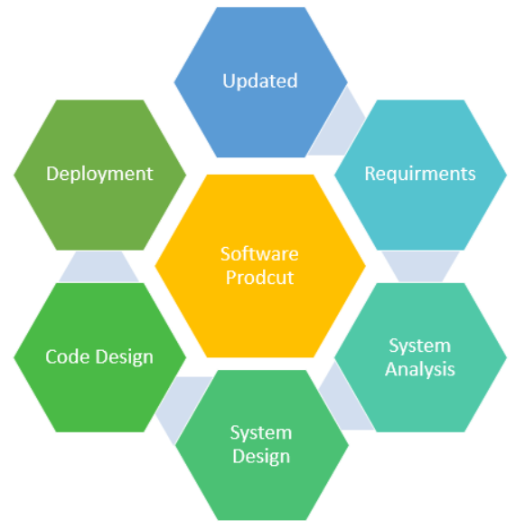
Why Software Engineering is Popular?
Large software :-In our real life, it is quite more comfortable to build a wall than a house or building. In the same manner, as the size of the software becomes large, software engineering helps you to build software.
Scalability :-If the software development process were based on scientific and engineering concepts, it is easier to re-create new software to scale an existing one.
Adaptability :-Whenever the software process was based on scientific and engineering, it is easy to re-create new software with the help of software engineering.
Cost:-Hardware industry has shown its skills and huge manufacturing has lower the cost of the computer and electronic hardware.
Dynamic Nature:-Always growing and adapting nature of the software. It depends on the environment in which the user works.

Slide 4
Software engineering challenges
Introduction :- Software engineering challenges refer to the difficulties and obstacles faced by professionals in the field of software engineering while developing, maintaining, and managing software systems. These challenges can arise at various stages of the software development life cycle and can be related to technical, managerial, or organizational aspects. Some common software engineering challenges include:
1.Complexity:- Software systems are becoming increasingly complex, with larger codebases, intricate architectures, and diverse technologies. Managing this complexity and ensuring that the software remains understandable and maintainable is a significant challenge.
2.Changing Requirements:- Requirements often change during the development process, either due to evolving business needs or incomplete initial specifications. Adapting to these changes while maintaining project timelines and budgets can be challenging.
3.Project Management: Efficiently managing resources, schedules, and budgets is crucial for successful software development. Poor project management can lead to delays, cost overruns, and reduced product quality.

Slide 5
4.Quality Assurance: Ensuring the quality of software is a persistent challenge. Testing all possible scenarios, finding and fixing bugs, and ensuring that the software meets user expectations require careful planning and execution.
5.Security: As software becomes more interconnected, security becomes a critical concern. Protecting software from various threats, such as cyberattacks and unauthorized access, requires robust security measures and constant vigilance.
6.Scalability: Designing software that can handle increased loads and user numbers is a challenge, especially as the user base or data volume grows. Ensuring scalability often involves thoughtful architectural decisions.
7.Legacy Systems: Many organizations have legacy systems that need to be maintained or upgraded. Integrating new technologies with existing systems while ensuring compatibility can be a significant challenge.
8.Team Collaboration: Effective collaboration among team members, especially in distributed or global teams, is crucial. Communication issues, cultural differences, and varying skill levels can pose challenges to teamwork.

Slide 6
9.Technology Changes: Rapid advancements in technology mean that software engineers need to constantly update their skills and adapt to new tools and frameworks. Keeping up with the latest technologies is essential for staying competitive.
10.Ethical Considerations: As software systems have a growing impact on society, ethical considerations become more critical. Engineers must consider the potential social, ethical, and legal implications of their work.

Slide 7

Be it Andhra Pradesh or Telangana, the soul is Telugu.
First they ignore you, then they laugh at you, then they fight you, then you win. -Mahatma Gandhi
Life is like riding a bicycle. To keep your balance, you must keep moving. -Albert Einstein

